Slide 1

War for Hope
Fight, or become the daemons of hell in this punishing CoH style RTS, with a focus on high intensity abilities and RPG style item pickups
Platform: Windows

Slide 2

Setting
Dystopian future, Earth no longer able to support life.
Search for new habitable worlds leads to colonization of planet “Hope”.
On Earth, Humanity is placed in stasis to be transported to Hope.
Unfortunately, the native creatures turn out to be hostile, emerging from the ground and being nicknamed Daemons for their biblical appearance.

Slide 3
Mood Board

Slide 4
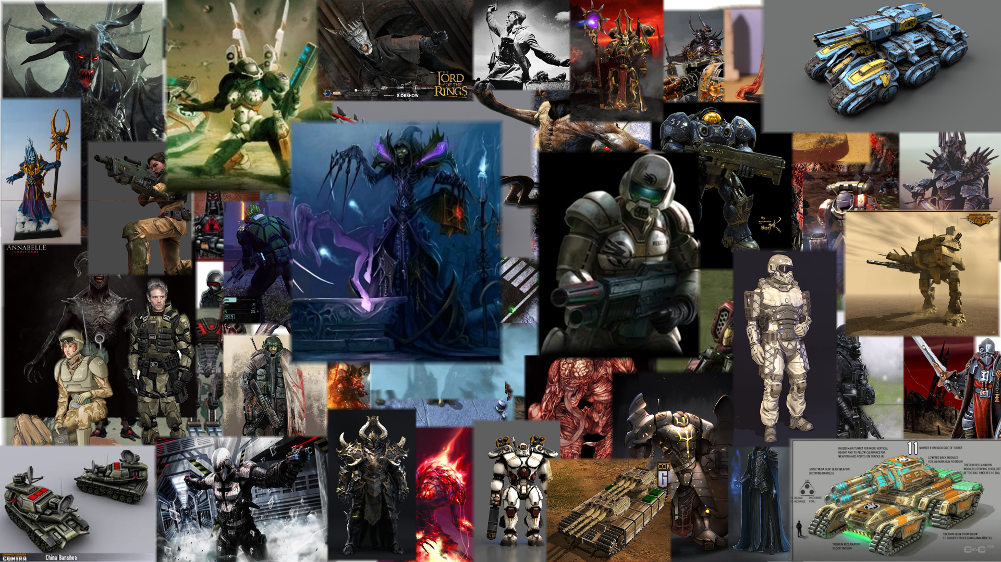

Slide 5
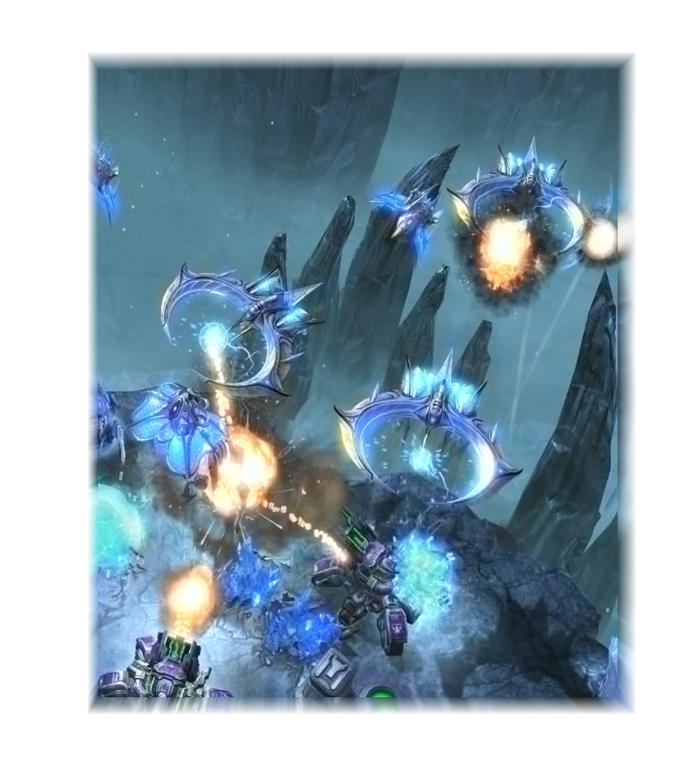
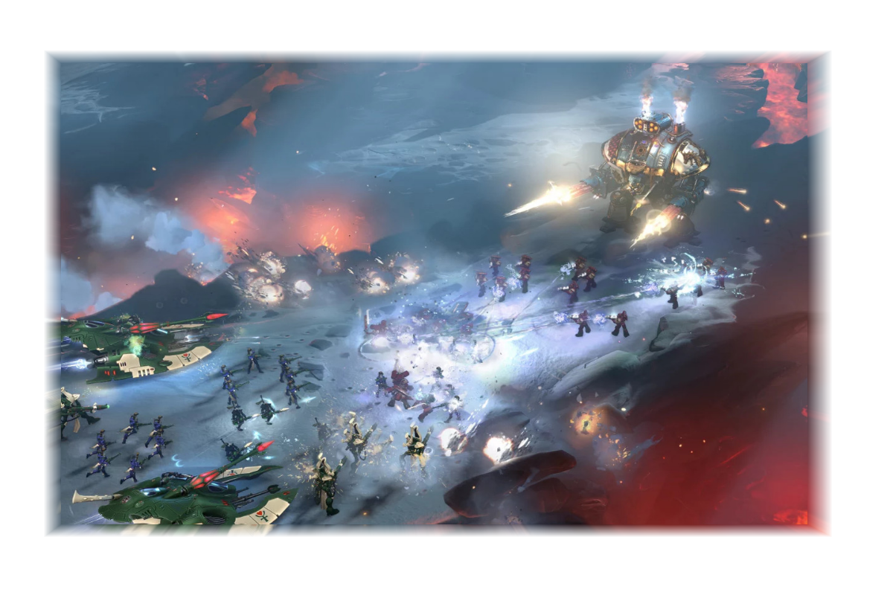

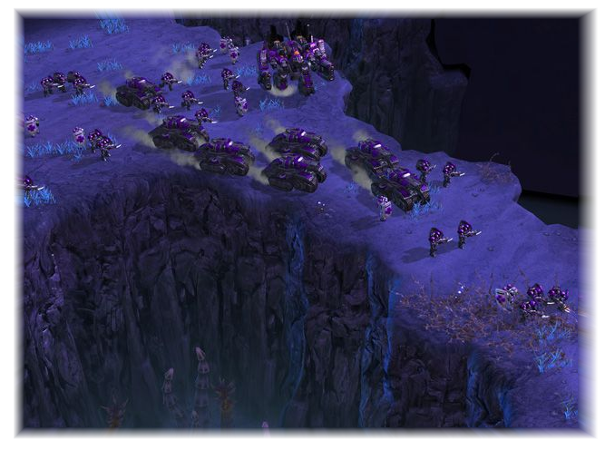

Terrain Overall
I really like the contrast of lava and ice here
Main colours, reds and cold shades
Semi-realistic feel / slightly cartoony with lots of colour saturation
Secondary colours, rocks and vegetation
Deep purples for night time environments
Bright ice colours make the game stand out

Slide 6
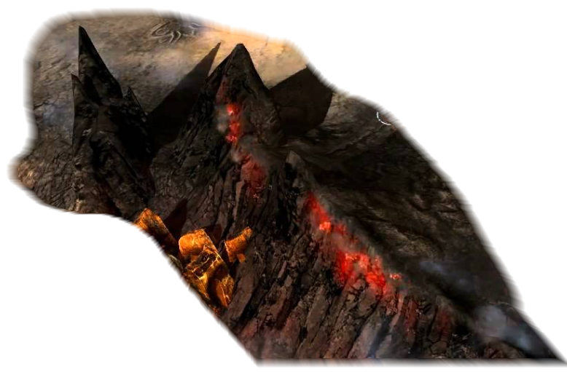
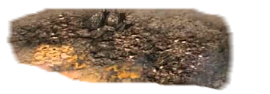
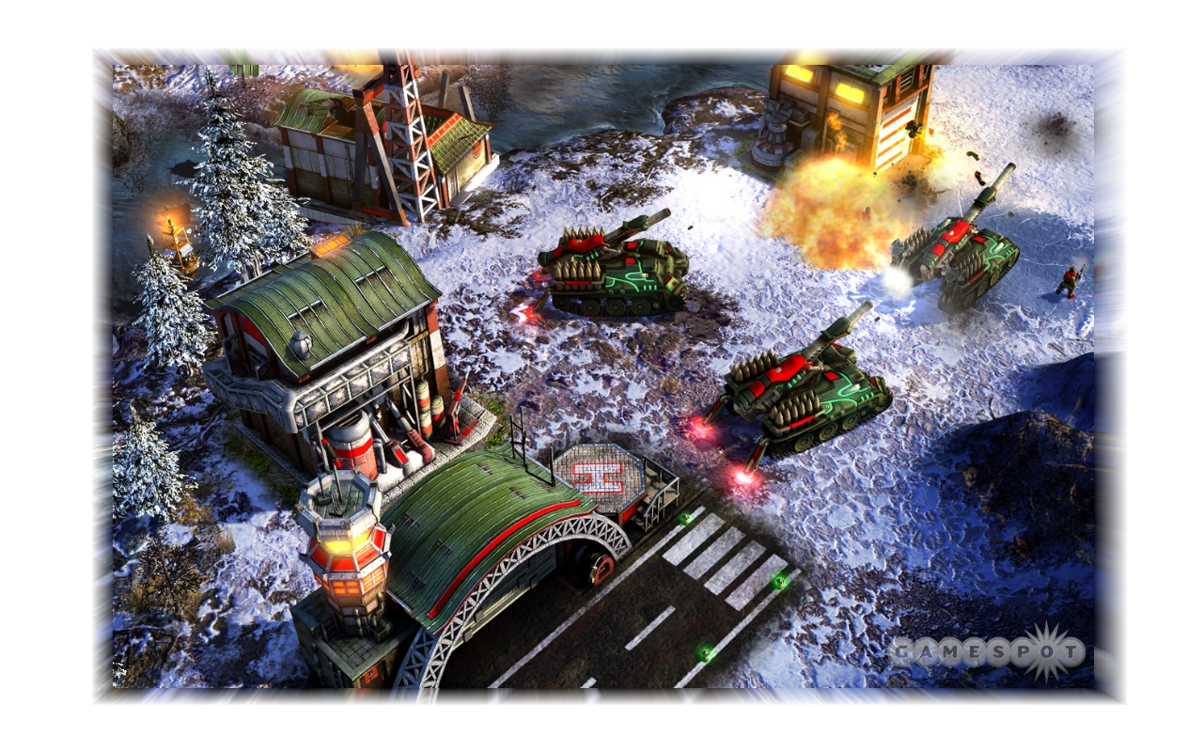
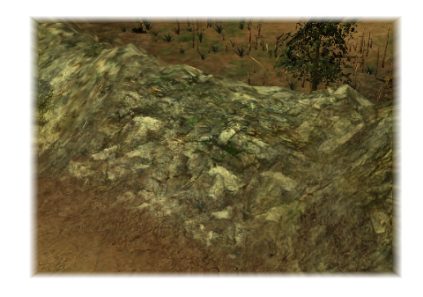
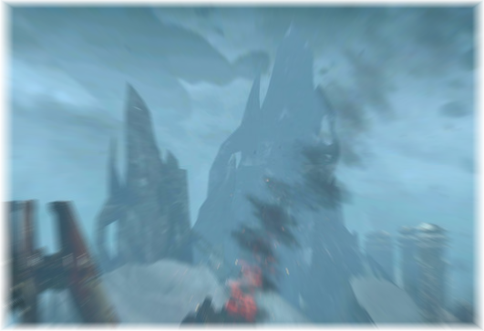
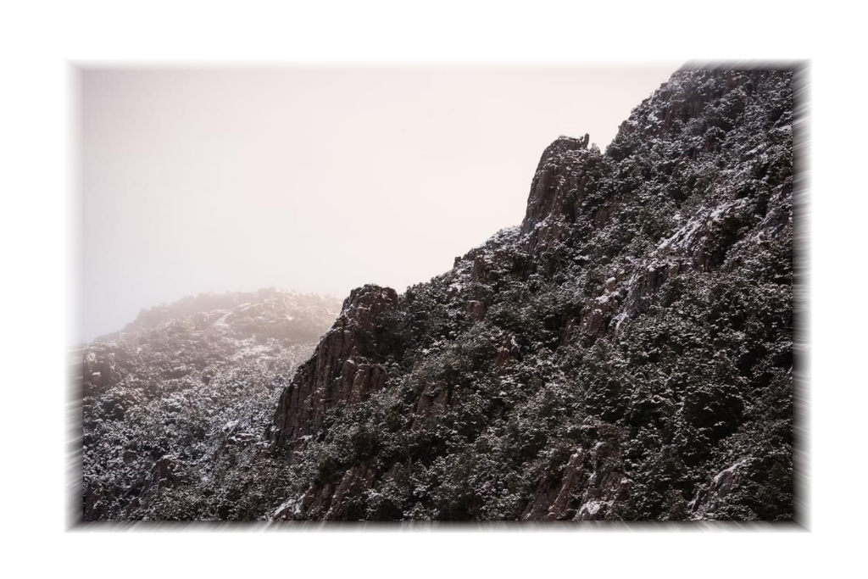
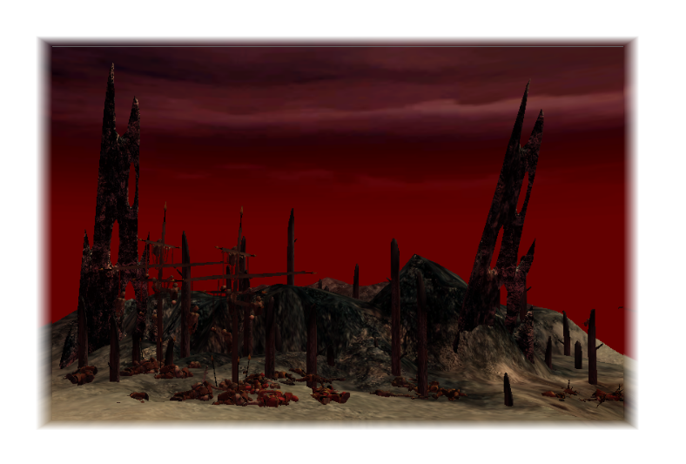
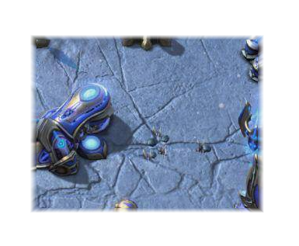
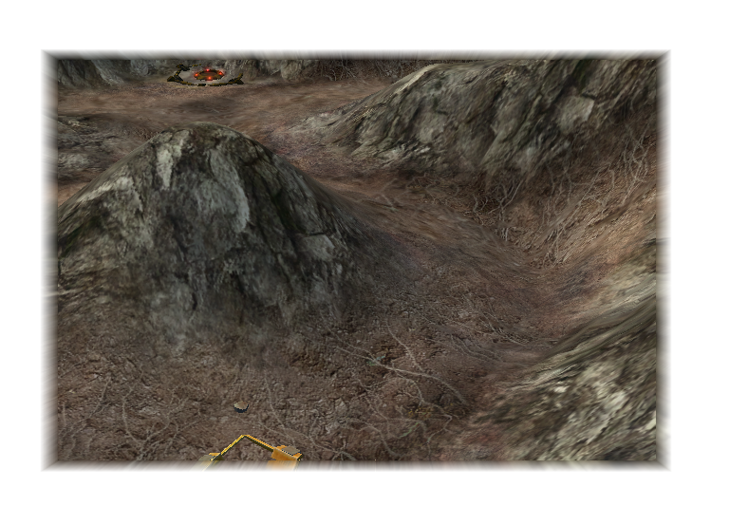
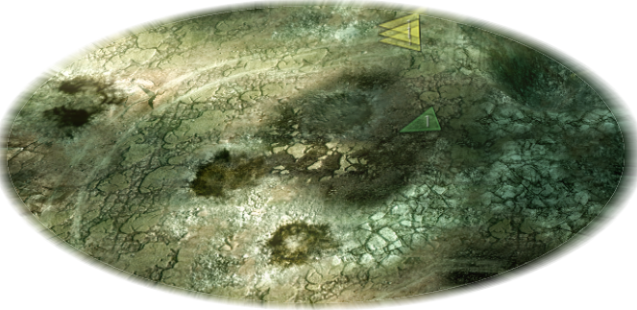
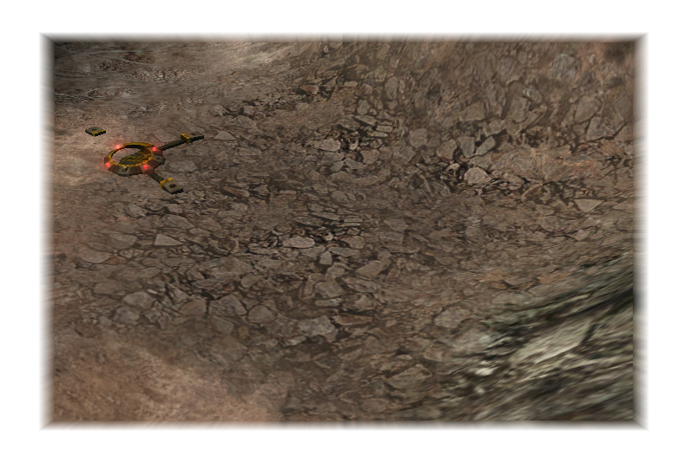
Terrain Detail
Gravely and rocky / icy hills
Unrealistic mountain shapes, tall and spikey. Dark colours with some reds or blues
Cracked, battle scarred and rocky terrain. Layered decals over a neutral colour

Slide 7
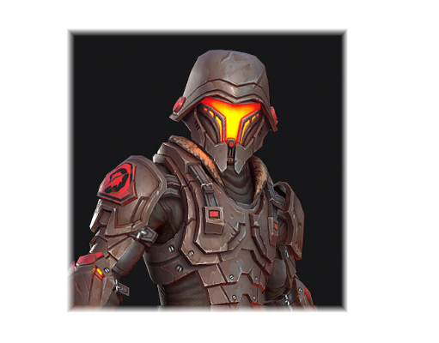
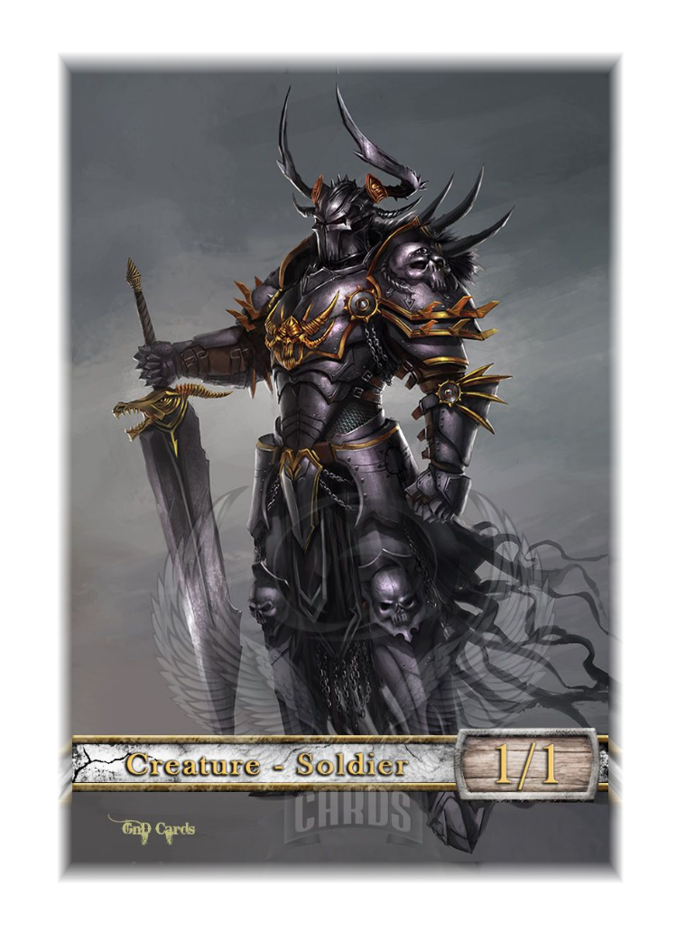
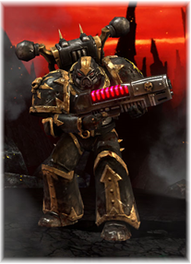
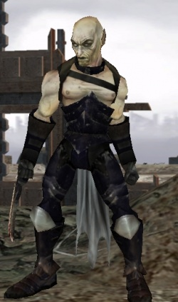
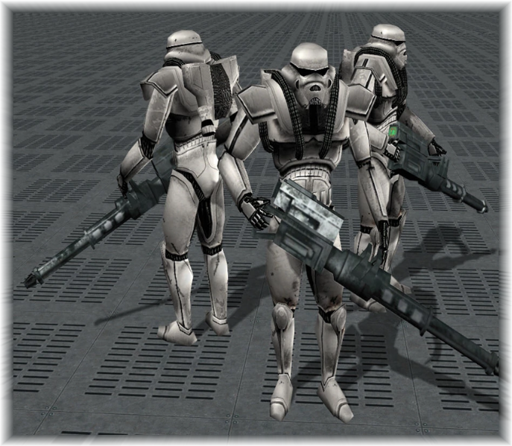
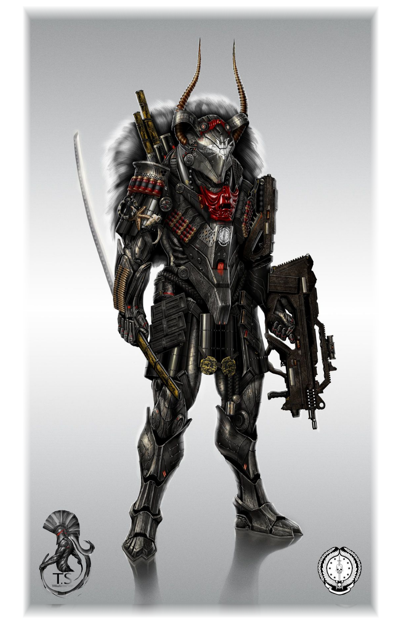
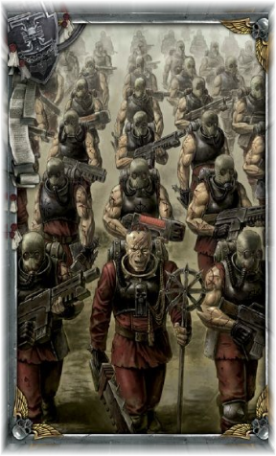
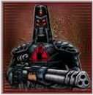
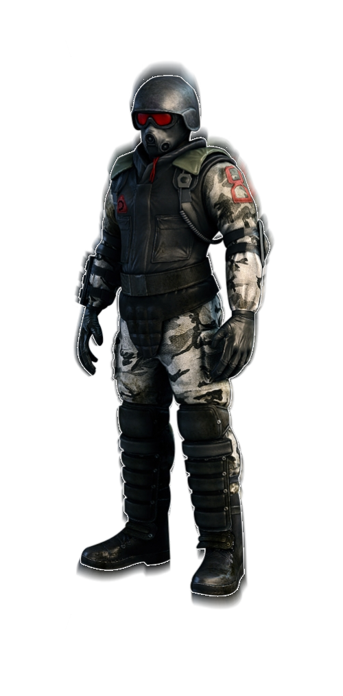



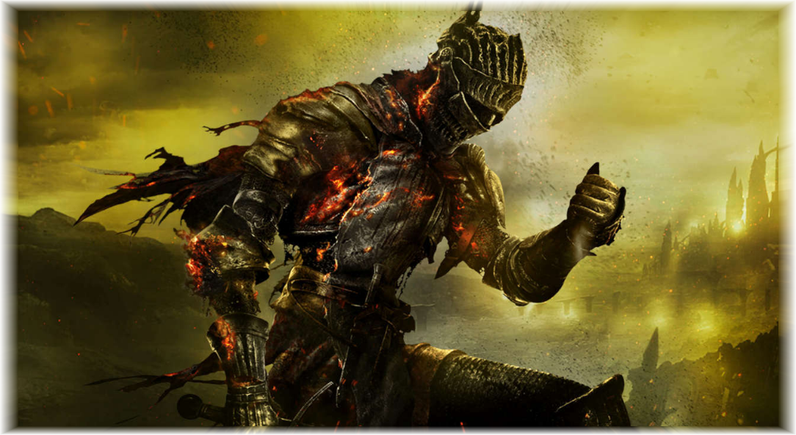
Evil Infantry
LIGHT INFANTRY
Lightly armoured, basic weapons. Variety of colours with metal being dark while clothing having some colour. Metallic with some army clothing. Wearing masks / helmet. Demonic symbols / iconography on some units. Some units sharing similar design to hero light infantry.
HEAVY INFANTRY
Thick bulky armour, somewhat robotic and medieval. Ridiculous heavy weapons. Emphasis on an intimidating helmet design. Fully armoured head to toe and clunky looking. Made from hell, so bright reds and glowing to represent otherworldly powers.

Slide 8
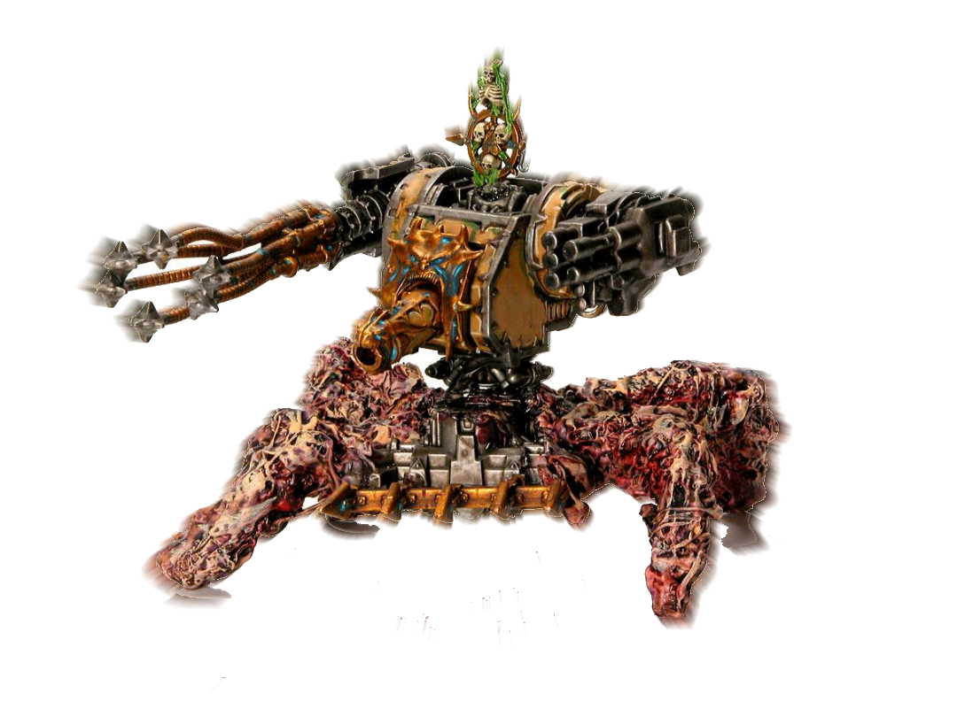
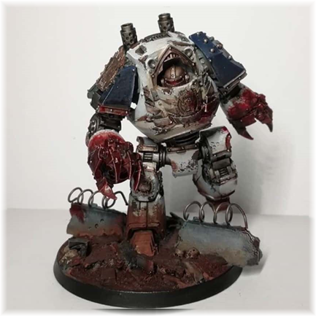
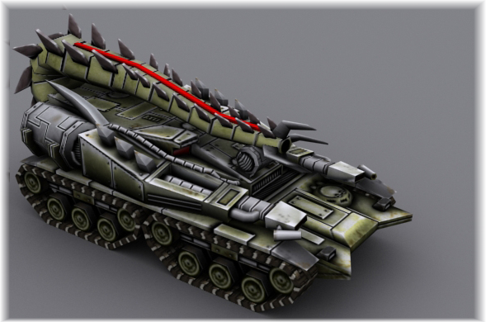
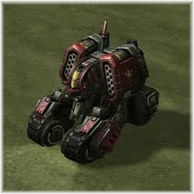
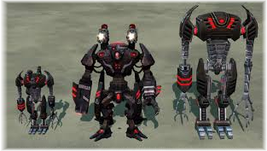

Evil Vehicles
Spikey and bulky. Perhaps infused with demonic entities or flesh. Designed to fit their purpose specifically. Dark metals with blood used as highlights. Bright lights, fire and smoke. Brutal claws and powerful looking weapons.

Slide 9
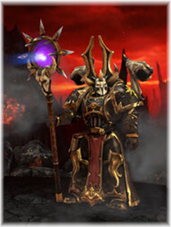
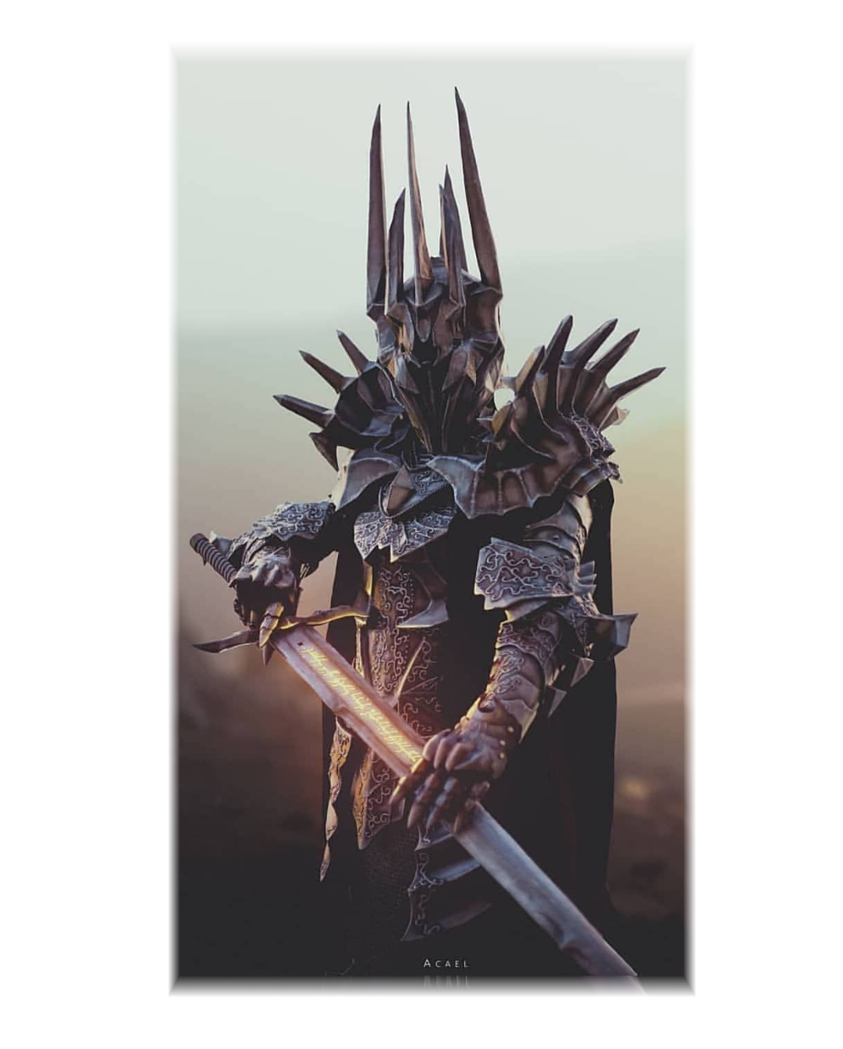
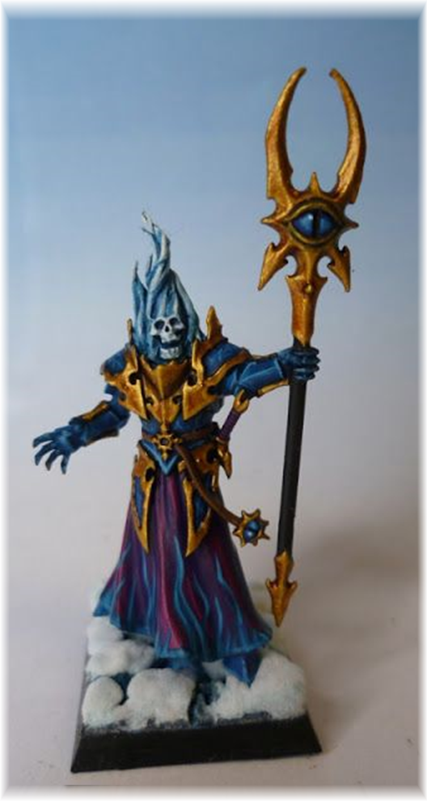
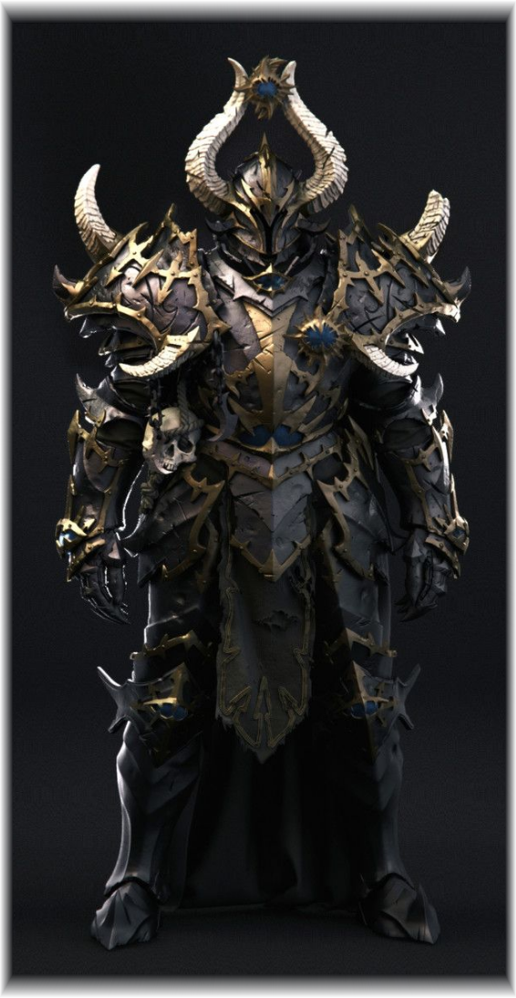
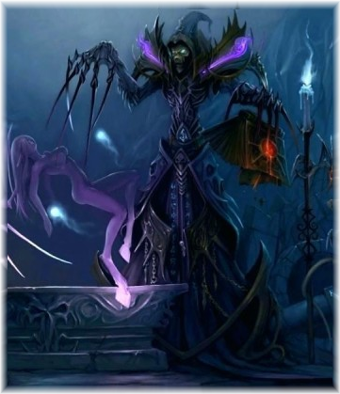
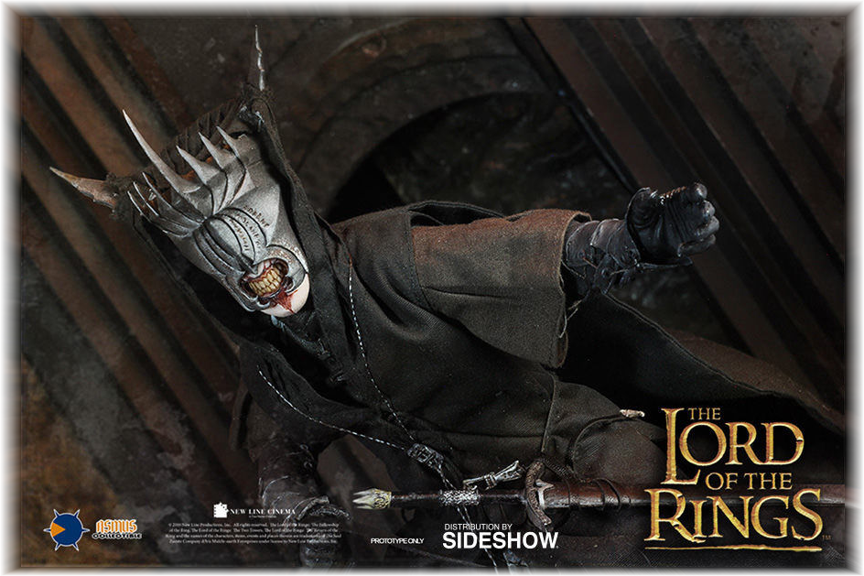
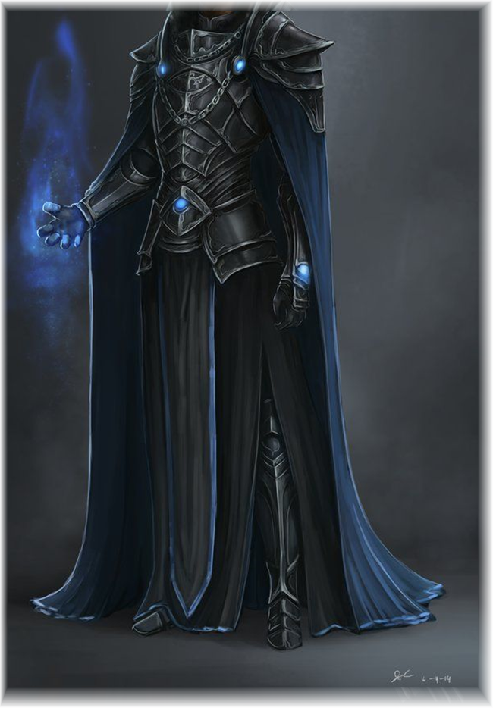
Character – Evil Commander “Necromancer”
“In human form, but completely covered in demonic armour, no one knows what truly writhes within. This creature is a great mockery of mankind.”

Slide 10
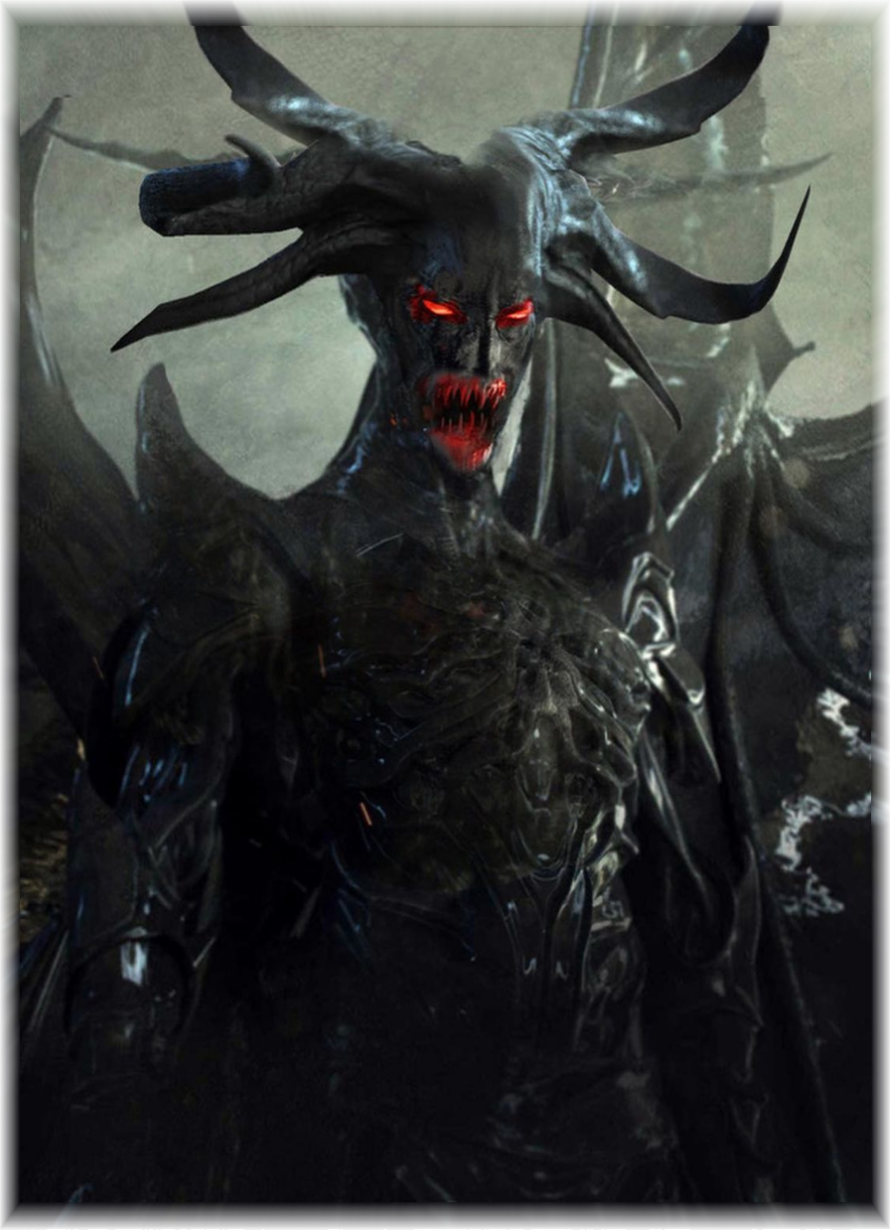

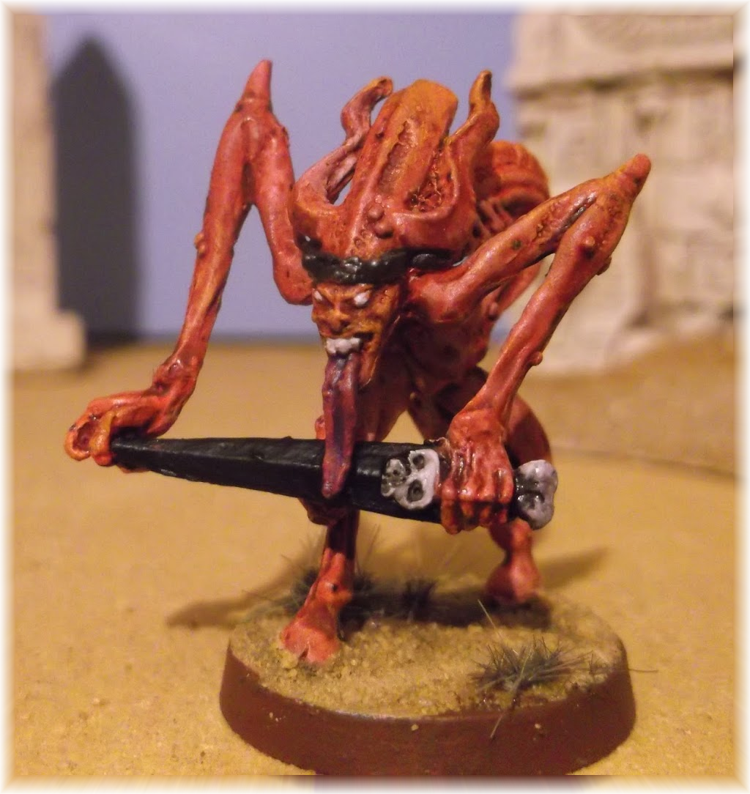

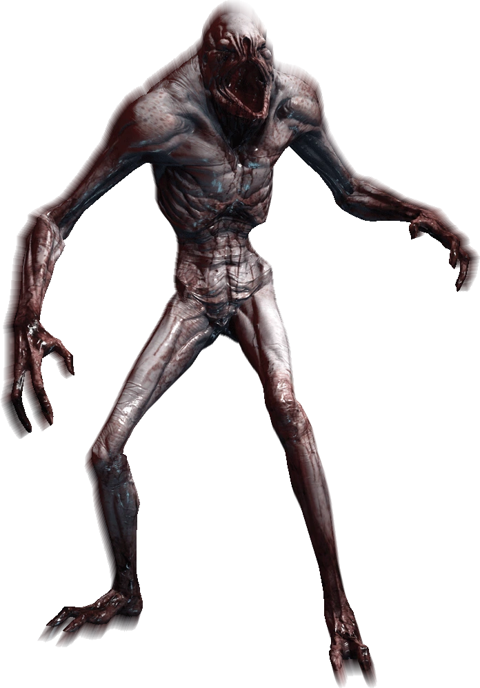
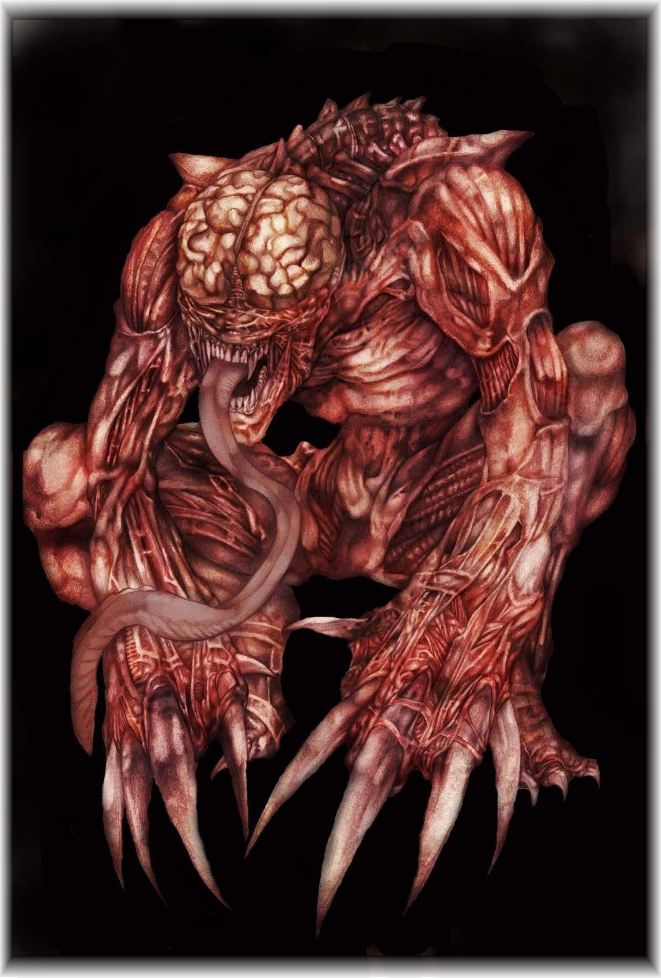
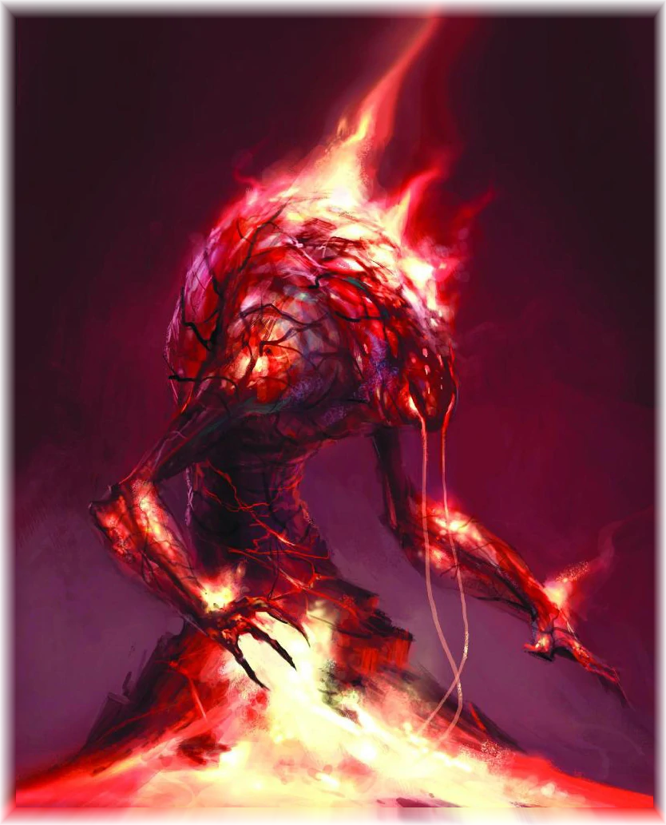
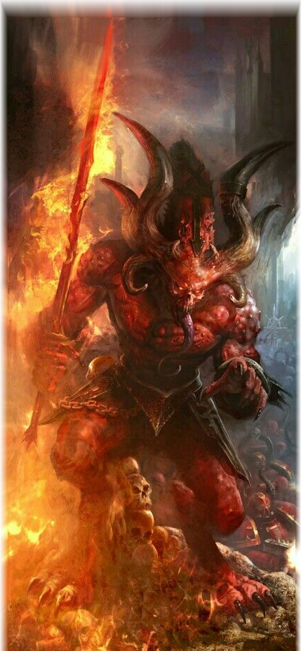

Evil Demons
Demons are used within the evil faction. I want a design that is somewhat humanoid but at the same time looks very foreign and sharp. Disturbing weapons and posture. Covered in magical fire effects to show they have unnatural power, like the evil heavy infantry.

Slide 11
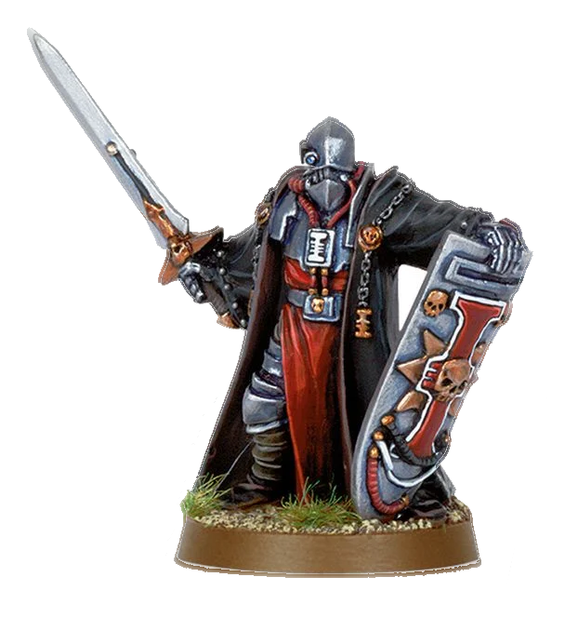
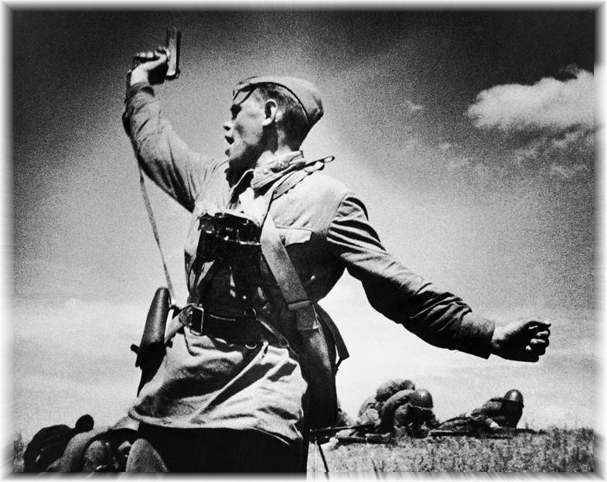
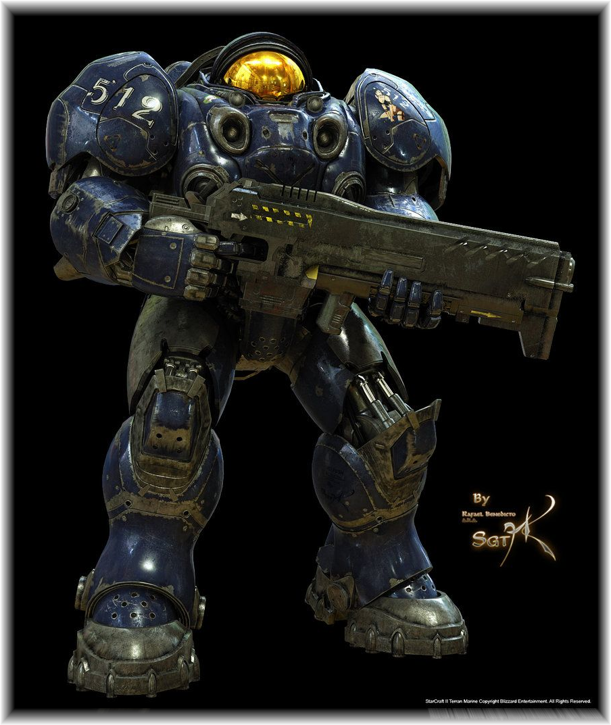
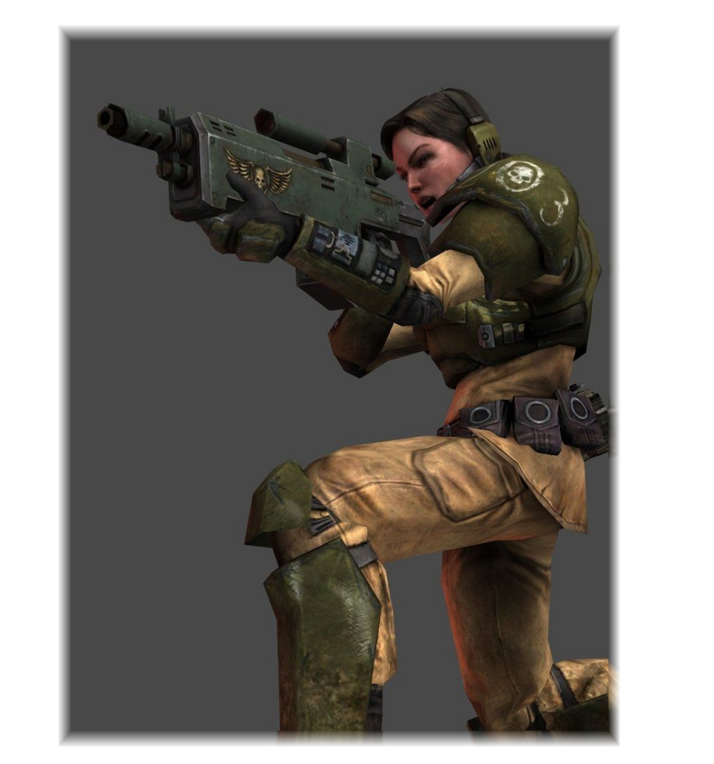
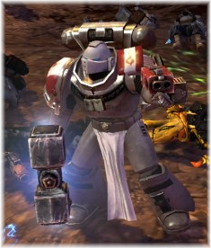
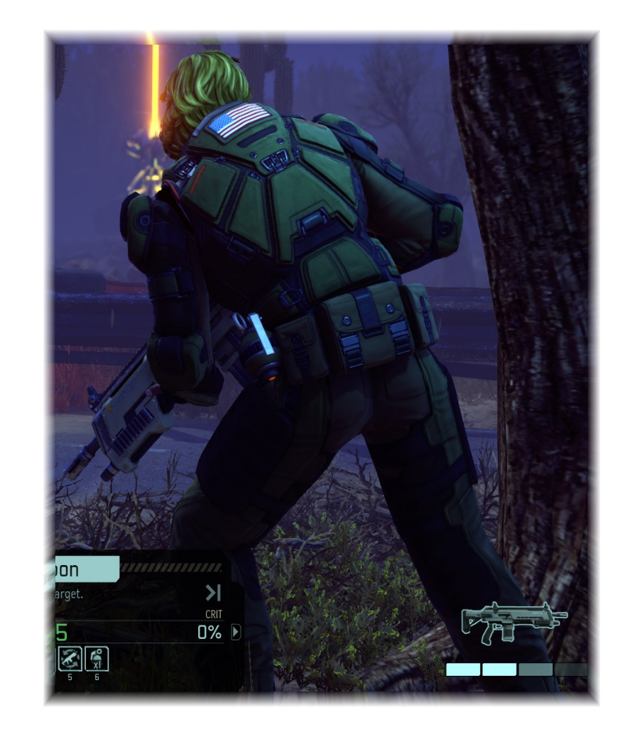
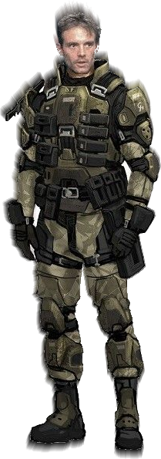






Hero Infantry
LIGHT INFANTRY
Realistic armour, camouflaged colours. Mostly poorly armed. Shades of green and yellow with patterns. Models could be shared through different units with just some new animations.
HEAVY INFANTRY
Advanced, high-tech with large dominating weapons. Heavily armoured but more circular than the villain heavy infantry. Religious iconography on some units perhaps. Bright colour highlights on cold steel metal base.

Slide 12






Hero Vehicles
Organised, covered in radars and scanning equipment. Loaded with massive barrels and other human weapons. Some vehicles look more put together in quick time using scrap metal, but more powerful vehicles look professional and devastating. Bright colours and painted metal

Slide 13





Character – Hero Commander “Champion”
“While the Administrator officially controls the planet, all follow the Champion. A mighty and proven warrior, a veteran of a hundred years of bloodshed, he knows how to fight Hell, and he fears no Evil.”

Slide 14
Mechanics

Slide 15
TO WIN, you must destroy the enemy HQ building, whilst not losing your own.

Slide 16

Range:
Every weapon has a min and max range, the pink line here represents combat, only the tank is in range, the infantry lacks the range to fight.

Slide 17

Health
Weapon Type:
Each weapon has a certain damage type, which has unique damage values for F.A. and each Armour Type
Fortified Armour:
Acts as a shield to protect HP. HP can’t be damaged in most cases when the unit has F.A.
HP:
For most units, when it reaches 0 the unit dies.
Armour Type:
Used to calculate DPS the unit receives. Some armours are weak to certain weapons but strong to others.

Slide 18














Types of Armour
Infantry
Vehicle
Vehicle Low (Light Walkers, Transports [TBC])
Vehicle Med (Heavy Walkers, Tanks)
Vehicle High (T4 human unit)
Infantry Low (Specialized Units [eg: Sniper])
Infantry Med (Swarm Units)
Infantry High (Basic Armoured Units)
Infantry Heavy Med (Mid-Game armoured units)
Infantry Heavy High (Late-Game armoured units)
Commander
Building
Building Low (Turrets)
Building High (HQ)
Daemon (Special Infantry)
Daemon Low (Basic Daemon Units)
Daemon Med (Heavy Daemon Units)
Daemon High (T4 daemon unit)

Slide 19








Damage Types
Tier 1
Basic Weapon
Special Use
Tier 2+
Armour Shredding
Heavy Weapons
Biological Damage
Armour Piercing
Anti-Vehicle
Explosive Damage
Daemon Weapon

Slide 20
Piercing Types vs Armour
Basic weapon, pretty ineffective
F.A.
^Generic effective damage, decent vs all targets and F.A.
^Special: Extremely ineffective against F.A.
Basic [B]: Standard Weapon, Basic Melee
Armour Shredding [A.S]: Especially effective against F.A, soft anti-vehicle weapon
Armour Piercing [A.P]: Poison, Flame, or Ability. Damages health through F.A.
Daemonic [D]: Strong damage like Heavy but ineffective vs tanks
Heavy [H]: Effective late game weapons vs most targets
Anti-Tank [AV]: Pure Anti-Tank Weapon, misses vs infantry most of the time
Explosive [E]: Most area of effect attacks and abilities. Good v all and F.A.
Biological [Bio]: Special Ammo, niche unit

Slide 21
A Graph to show the Damage output in % for weapon Damage Types against Armour Types
Armour Type
Damage (%)
Note: Damages through F.A.
Weapon Damage Type

Slide 22


Cover
Certain environmental features will reduce incoming ranged damage for squads standing inside it, such as craters and sandbags.
This adds a degree of strategy where the player must choose to fight or retreat to a position with cover in it.
As well as this, due to the subterranean life of the Daemons faction, their non-human units are de-buffed when in areas of brightness.

Slide 23

Tanks
Unlike Infantry, Heavy Tanks do not use Health, instead they only use Fortified Armour.
This makes basic weapons rather ineffective against them, whilst anti-tank or explosive damage does much more damage

Slide 24

Morale and Panic
Most infantry units have morale
While in combat units take morale damage.
Certain weapons do much higher morale damage such as machine guns and flame weapons.
When morale gets low the unit gets Supressed, making them very slow and shoot slower.
If the unit does not have its suppression broken, it may choose to retreat back to the HQ.
Some evil units will get Enraged instead of retreating, which forces them to run forward and engage the closest unit in melee.
Uniquely, Daemons do not know fear or rage, and so do not use morale

Slide 25

Retreat!
Most infantry units can be retreated, this can be a small retreat or a full retreat.
While retreating units take much less damage and run faster, but can’t be controlled.
A small retreat acts like an ability, you target where you want them to run in a short area and they’ll go to it with the bonuses. This has a cooldown so you cannot keep using it all the time. Small retreat must be done in the direction of the HQ! Small retreat is good to return to a defensible location, as in war the person who chooses the field of battle wins.
A full retreat makes the squad run back to the HQ building. This is good when you need to run away completely. This is good if the unit is about to be destroyed and needs to be withdrawn completely.

Slide 26

Jumping and Teleporting
Certain units can gain abilities to jump over impassable terrain, or teleport over it. This can even be combed with special abilities to impact the field when the unit lands.
This is useful for flanking enemy positions, or retreating from unfavourable engagements.

Slide 27




RPG Elements
Critical hits: Weapons have a chance to deal bonus damage.
XP: Killing enemy units grant XP to the fighting units. After a certain amount of XP has been accumulated units Level up. Levelling up increases stats.
Looting: Dead enemies can be looted to gain money, and a chance to find a rare weapon. Rare loot can be equipped to the looting squad to improve their stats.
Accuracy: Weapons can miss (0 damage) or graze (reduced damage), F.A. increase chance of graze.

Slide 28


Abilities
Most units will have more than 1 ability
Abilities include passive (always on) and activatable abilities
These might do many things, damage the enemy, throw them, heal allies, or even throw your own troops
As well, some abilities can be used to increase stats such as speed, damage, mass and health
You can also hold shift to use an alternative version of some abilities, for example an ability to throw an enemy may be used alternatively to throw your own troops to safety, or closer to engage in melee

Slide 29



Resources
Primary Resource – ‘Minerals’: Every unit costs minerals to produce
-- COMMON
Secondary Resource – ‘Energy’: High-tier units, especially vehicles, cost energy to produce
-- RARE
Global Ability Resource – ‘Strategic Resource’: Used to cast a few specific devastating abilities
-- SUPER RARE!

Slide 30


Resources
Mineral and Energy resources are present on the map in circular fields.
Minerals appear often, Energy crystals are rarer and more desired.
They are controlled by a Resource Point.
Units can stand next to the point for a time to gain control of the resources, allowing them to be gathered.
The HQ will also produce Minerals to prevent you from running out completely.

Slide 31

Resources – How to generate
Capture the Resource Point. It will produce the resource very slowly
Pay Minerals to add a Protective Structure (Node) onto the Resource Point. Prevents enemies capturing it and increases resource generation. If the Node is destroyed, the enemy can steal the Resource Point by capturing it
Once you have a Node, you can make Harvesters. They gather Resources from around the Resource Point at a fast rate, but have no weapons and are vulnerable to being attacked, destroyed, or stolen (by the enemy capturing the Resource Point)

Slide 32

Example Map
“Safe”: Easy to Capture and Defend.
Close to base allows for reinforcements and greater risk for the enemy trying to attack here. Almost guaranteed resource generation.
“Forward”: Easy to capture, but needs to be defended
Early on can be captured as there is no fighting, but if you are retreating the point might be attacked. Mostly safe resource generation.
“Contested”: Average to capture, hard to defend
Depending on player choices, someone may capture these, or there may be constant fighting. Powerful resources will be positioned here. Often in the middle of both of the bases. Risky resource generation.

Slide 33


Resources – Strategic Resource
Strategic resource is gained by controlling special Resource Points.
These Strategic Points cannot have a Node and cannot have Harvesters.
Strategic Points will constantly be stolen by both players to deny the opponent a strategic advantage.

Slide 34

Tech System
3 technology tiers, spend resources to increase tier.
Increasing tech tier allows player to make more advanced units and upgrade your existing units with better weapons or armour.
This will prevent you building units during the upgrade duration.
Total units for both factions combined: 20
Tier 1 (Starting): 4 infantry units and 1 Commander
Tier 2: 2 elite infantry units and 1 walker tank
Tier 3: Main Battle tank and Super Unit

Slide 35
Factions
Hero: Humanity
Strengths: Powerful mid game infantry and very powerful late game vehicles, manoeuvrable via jumps and teleports, swarm squads have large squad sizes whilst small squads have good health
Weaknesses: Fleshy early game units, weaker melee walker, lacking on some abilities as non-magical units
Key Point: Defensive Race. Excellent Ranged Weapons and Defences
Villain: Legion of Hell
Strengths: Strong melee, able to get heavy infantry early on, fields Daemons who are immune to morale, excellent damage output, possess magic so field more variety of abilities
Weaknesses: Generally expensive, non-armoured infantry are glass-cannons, somewhat lacking for good ranged units, receive combat penalties when in bright areas, generally small squad sizes
Key Point: Aggressive Race. Excellent Damage and either is immune or benefits from loosing morale

Slide 36

Example unit

Slide 37

Most code done, game playable in some form start to end

